Slide 1
Computing in the Arts
Sound delay/Sound phased array
by:
D. Lotnyk
Instructor: Graeme Bailey

Slide 2
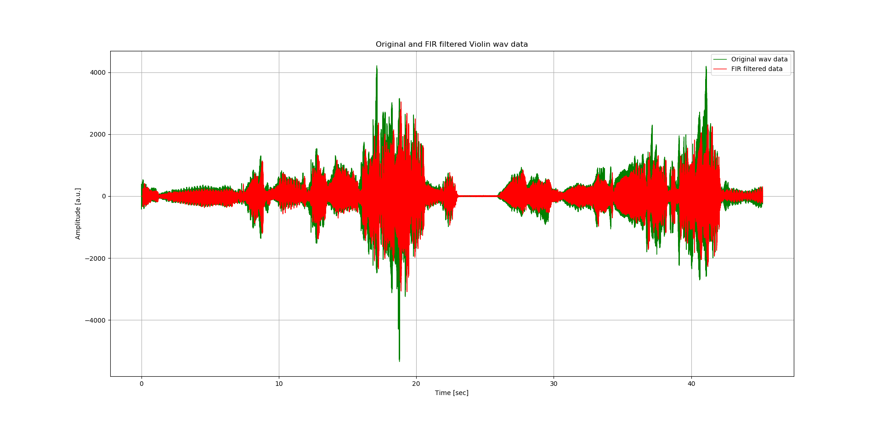
Signal processing

Slide 3
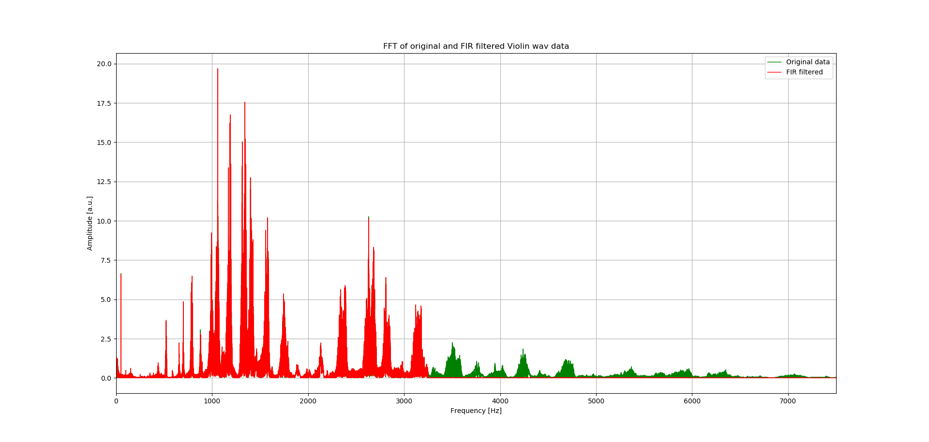
Fast Fourier Transform (FFT) of the signal

Slide 4
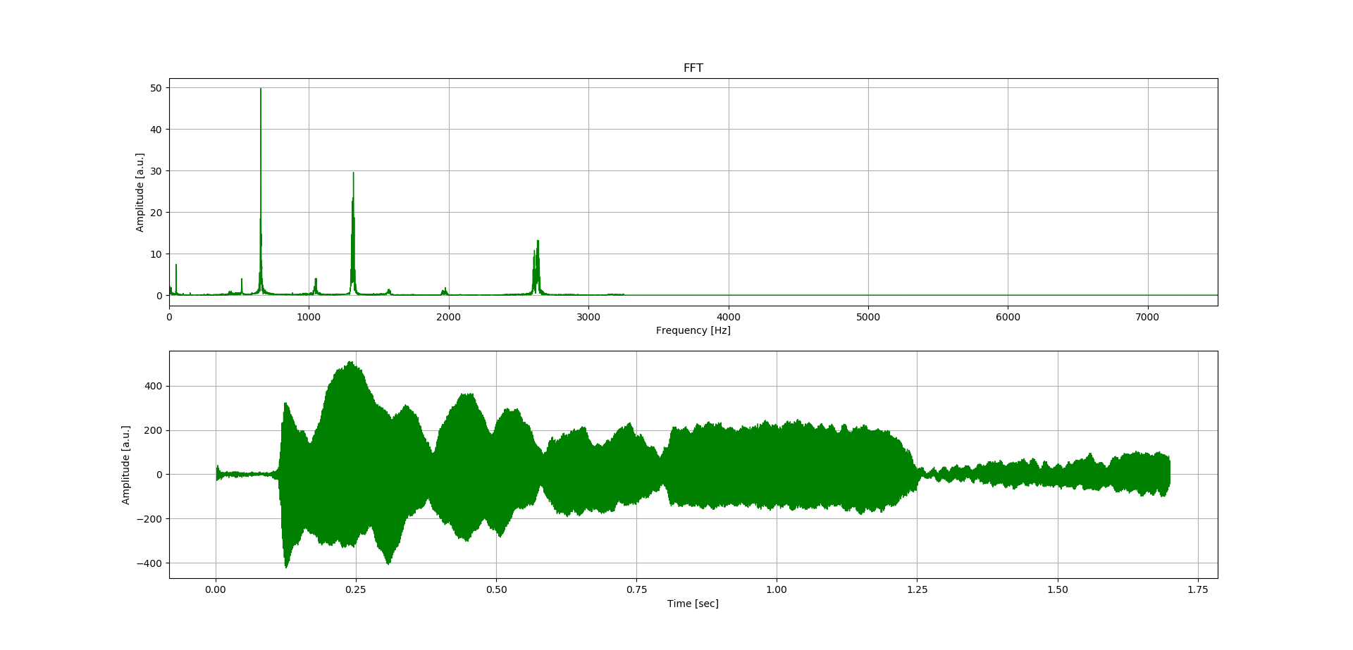
Sample

Slide 5
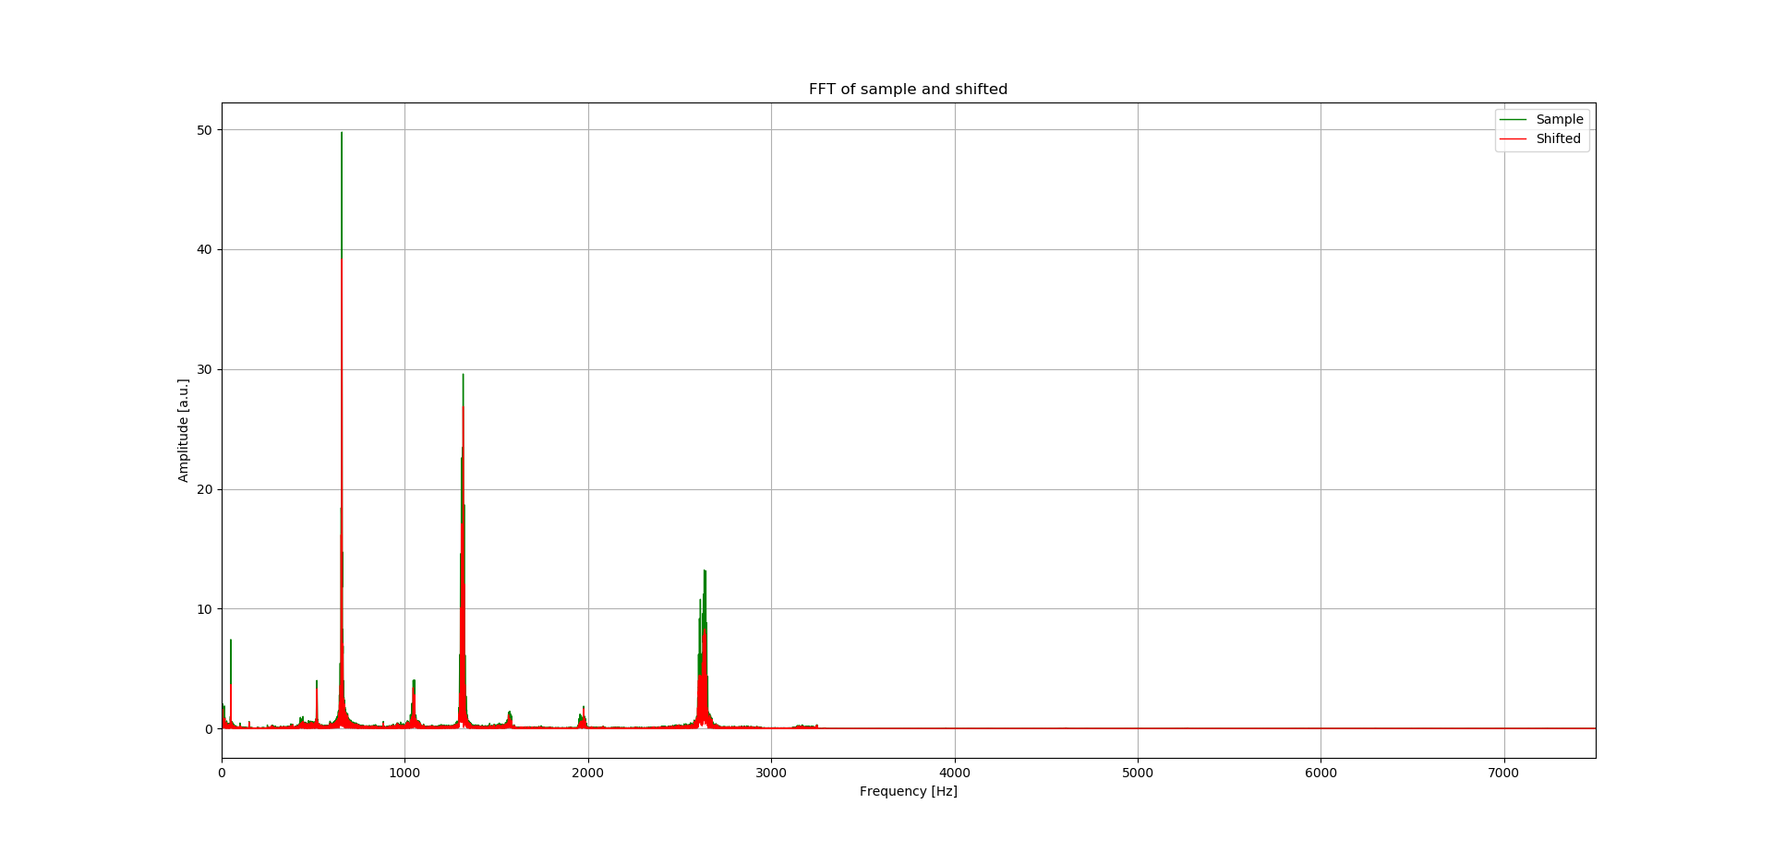
FFT peak difference between synchronized signals and half-shifted.

Slide 6

sample
Increasing delay
≈ 0.04 s
Decreasing delay
≈ 0.01 s

Slide 7
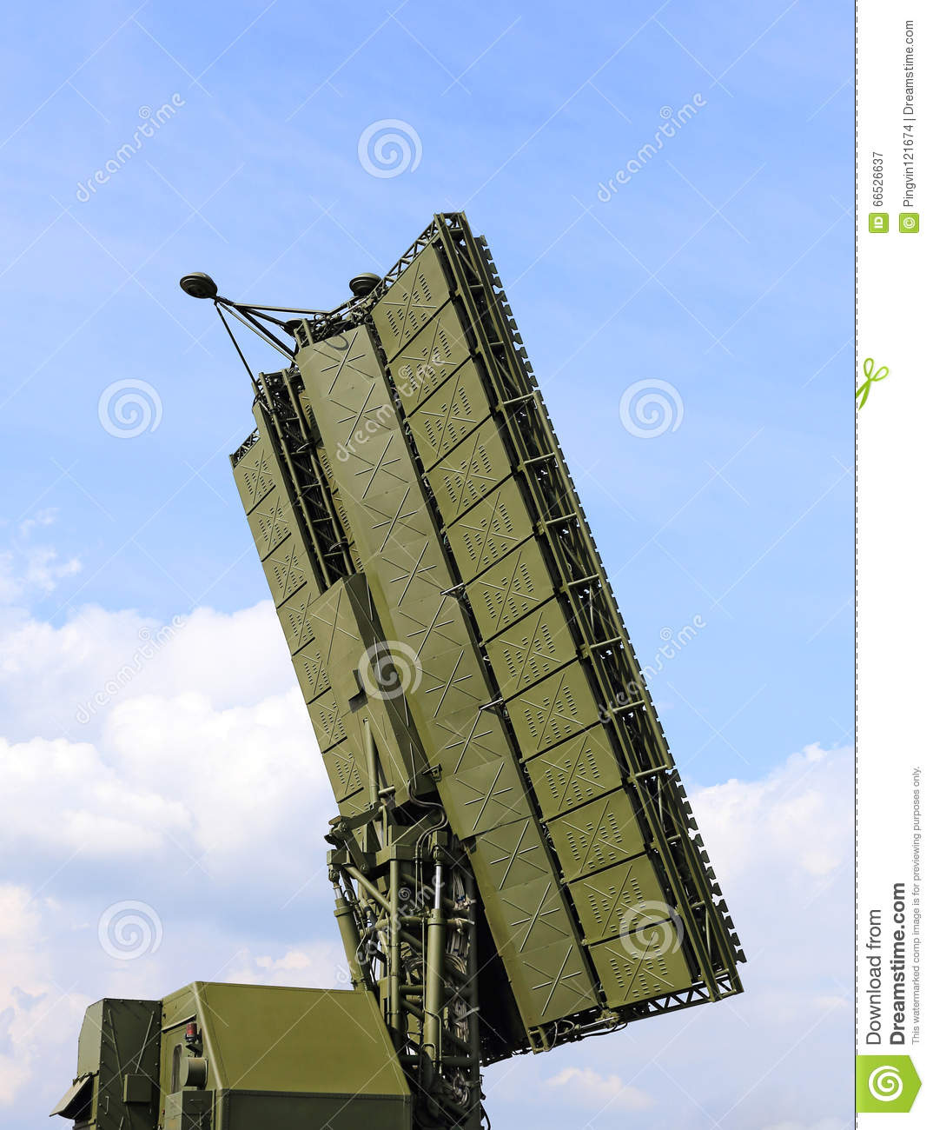
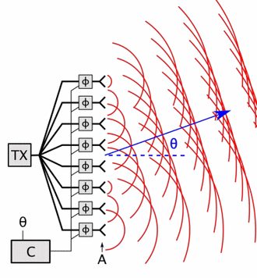
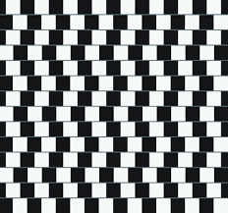
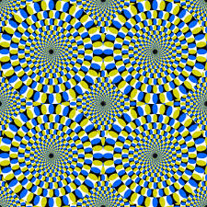
Phased array antenna/emitter. Possibility to confuse listener?

